Slide 1
MUSIC PLAYER
Mini project
Presented By: AJITHKUMAR K
Batch. No: 6907

Slide 2
INTRODUCTION :
Our product is a offline based music player that allows users to listen to their music libraries on their home computer. This project is created by using core Java concepts .

Slide 3
TECHNOLOGY:
In my project prior technology used is Core Java concepts. The concepts which I have been used in this project is given below ,
File handling
Case and Loops
Exception handling

Slide 4
Features:
The features in this music players are
Classified in two ways as Admin functions and Customer functions.
(i)Admin
Signup
Login
Add Songs to player
Remove Songs to player

Slide 5
(ii) Customer
Customer side features are,
signup
Login
View song list
Play song previous / backward
add song to favourite list
view favourite song list

Slide 6
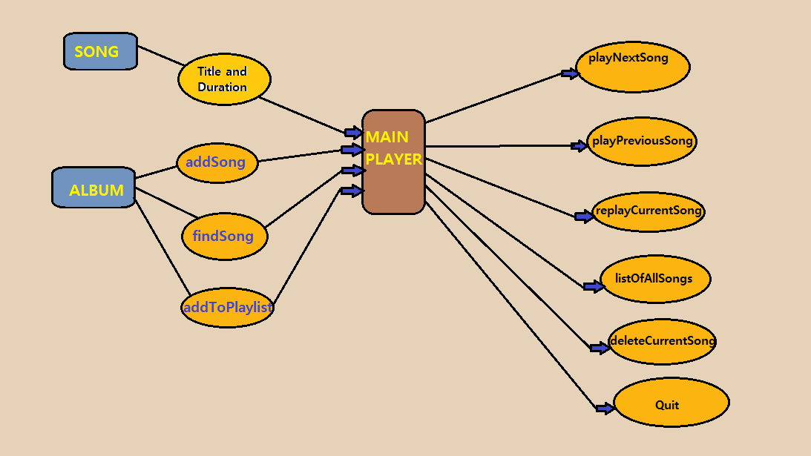
USE CASE DIAGRAM :

Slide 7
THANK YOU

